Slide 1

St Augustine of Canterbury Catholic Primary School
Reception Induction Information For Parents/ Carers
June 2023

Slide 2
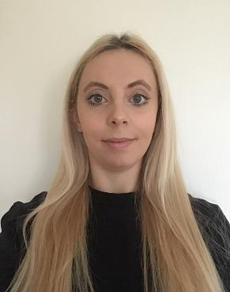
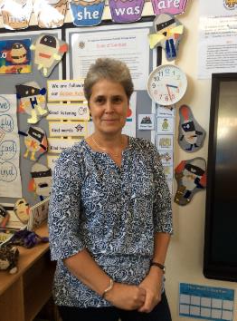
Reception Class teachers.
We look forward to getting to know you and your child over the coming weeks and welcoming the children to St Augustine’s
Miss Blackford will be our Reception class teacher from September 2023. She will be in school in July for the transition activities.
Mrs Allen is the current Reception class teacher.

Slide 3
Introduction
Early Years Foundation Stage curriculum for Reception aged children and the Early Learning Goal outcomes the children will work towards during the Reception year.
Teaching and learning linked to the Early Years Foundation Stage Profile introduced in Sept 2021
Practical tips on how to support your child at home to help them to be ‘school ready’
General information about preparing for September.

Slide 4
The Reception curriculum is based on EYFS Key principles
Every child is unique
Children learn to be strong and independent through positive relationships
Children learn and develop well in enabling environments, with teaching and support from adults; reflects their interests and needs and helps build learning over time.
Children learn and develop in different ways and at different rates
With these four principles in place, learning and development can thrive.
The ‘Characteristics of Effective Learning’ are modelled and nurtured throughout the Reception year:
Playing and Exploring-engagement in activities
Active Learning- motivation to learn
Creating and Thinking critically- why and how

Slide 5
EYFS Curriculum
The EYFS Curriculum is divided into 7 areas, 3 Prime and 4 Specific areas of learning:
The Prime Areas:
Communication & Language
Personal, Social and Emotional Development
Physical Development
The Specific Areas:
Literacy
Mathematics
Understanding the World
Expressive Arts & Design

Slide 6

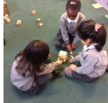
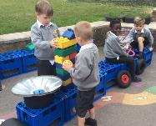
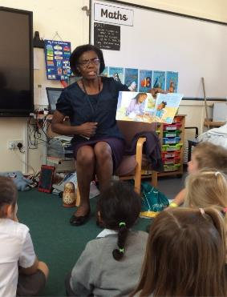
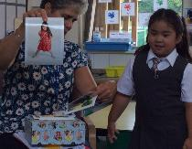
Communication
& Language
Listening, Attention & Understanding:
Listen attentively and respond to what they hear with relevant questions, comments and actions when being read to and during whole class discussions and small group interactions;
Make comments about what they have heard and ask questions to clarify their understanding;
Hold conversation when engaged in back-and-forth exchanges with their teacher and peers.
Speaking:
Participate in small group, class and one-to-one discussions, offering their own ideas, using recently introduced vocabulary;
Offer explanations for why things might happen, making use of recently introduced vocabulary from stories, non-fiction, rhymes and poems when appropriate;
Express their ideas and feelings about their experiences using full sentences, including use of past, present and future tenses and making use of conjunctions, with modelling and support from their teacher.

Slide 7
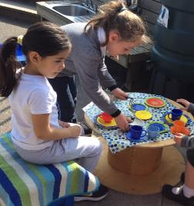
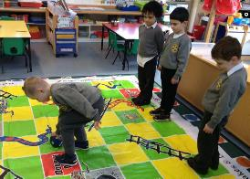
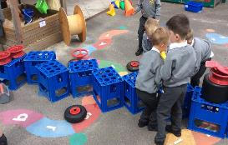
personal, social & emotional development
Self-Regulation:
Show an understanding of their own feelings and those of others, and begin to regulate their behaviour accordingly;
Set and work towards simple goals, being able to wait for what they want and control their immediate impulses when appropriate;
Give focused attention to what the teacher says, responding appropriately even when engaged in activity, and show an ability to follow instructions involving several ideas or actions.
Managing Self:
Be confident to try new activities and show independence, resilience and perseverance in the face of challenge;
Explain the reasons for rules, know right from wrong and try to behave accordingly;
Manage their own basic hygiene and personal needs, including dressing, going to the toilet and understanding the importance of healthy food choices.
Building Relationships:
Work and play cooperatively and take turns with others;
Form positive attachments to adults and friendships with peers;
Show sensitivity to their own and to others’ needs.

Slide 8
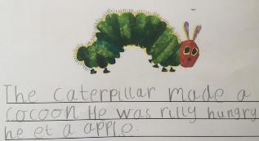
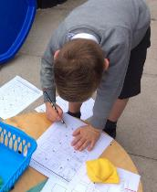
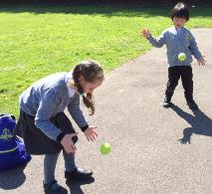
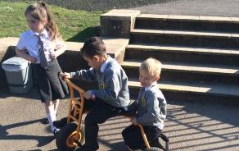
Physical development
Gross Motor Skills
Negotiate space and obstacles safely, with consideration for themselves and others;
Demonstrate strength, balance and coordination when playing;
Move energetically, such as running, jumping, dancing, hopping, skipping and climbing.
Fine Motor Skills
- Hold a pencil effectively in preparation for fluent
writing, using the tripod grip in almost all cases;
- Use a range of small tools, including scissors, paint
brushes and cutlery;
- Begin to show accuracy and care when drawing.

Slide 9
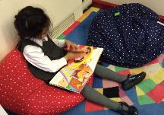
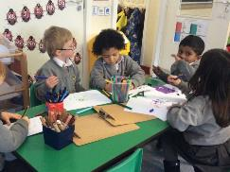
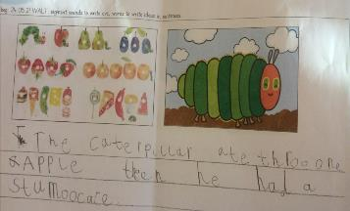
Literacy
Comprehension:
- Demonstrate understanding of what has been read to them by
retelling stories and narratives using their own words and recently
introduced vocabulary;
- Anticipate (where appropriate) key events in stories;
- Use and understand recently introduced vocabulary during
discussions about stories, non-fiction, rhymes and poems and
during role-play.
Word Reading:
Say a sound for each letter in the alphabet and at least 10 digraphs;
Read words consistent with their phonic knowledge by sound-blending;
Read aloud simple sentences and books that are consistent with their phonic knowledge, including some common exception words.
Writing:
- Write recognisable letters, most of which are correctly formed;
Spell words by identifying sounds in them and representing the sounds with a letter or letters;
Write simple phrases and sentences that can be read by others.

Slide 10

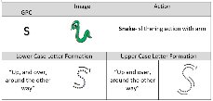






Resources to support
Reading and Writing skills development
We use the Unlocking Letters and Sounds programme to teach phonics, teaching sounds linked to letters systematically.
The children learn actions matched to the initial sounds they learn, to aid recall of these.
We use interactive online resources to practise and embed learning.
The children learn to blend sounds together to read simple words.
Blending sounds linked to letters for word reading goes hand in hand with writing and gradually the children learn to break up (segment) sounds in a word to write words, captions and sentences.

Slide 11
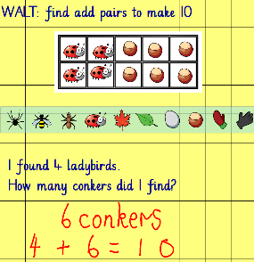
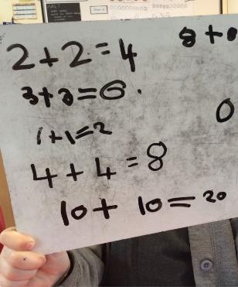
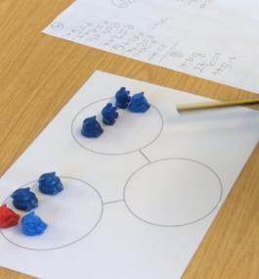
Mathematics
Number:
Have a deep understanding of number to 10, including the composition of each number;
Subitise (recognise quantities without counting) up to 5;
Automatically recall (without reference to rhymes, counting or other aids) number bonds up to 5 (including subtraction facts) and some number bonds to 10, including double facts.
Numerical Patterns
Verbally count beyond 20, recognising the pattern of the counting system;
Compare quantities up to 10 in different contexts, recognising when one quantity is greater than, less than or the same as the other quantity;
Explore and represent patterns within numbers up to 10, including evens and odds, double facts and how quantities can be distributed equally.

Slide 12
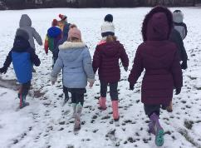
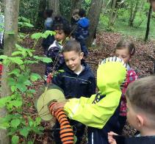
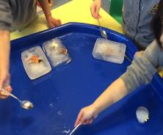
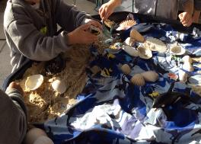
Understanding the worlD
Past and Present:
Talk about the lives of the people around them and their roles in society;
Know some similarities and differences between things in the past and now, drawing on their experiences and what has been read in class;
Understand the past through settings, characters and events encountered in books read in class and storytelling.
People, Culture and Communities:
Describe their immediate environment using knowledge from observation, discussion, stories, non-fiction texts and maps
Know some similarities and differences between different religious and cultural communities in this country, drawing on their experiences and what has been read in class;
Explain some similarities and differences between life in this country and life in other countries, drawing on knowledge from stories, non-fiction texts and when appropriate, maps.
The Natural World:
Explore the natural world around them, making observations and drawing pictures of animals and plants;
Know some similarities and differences between the natural world around them and contrasting environments, drawing on their experiences and what has been read in class;
Understand some important processes and changes in the natural world around them, including the seasons and changing states of matter.

Slide 13
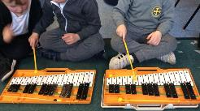
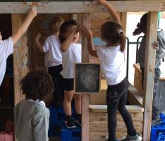
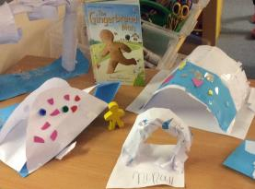
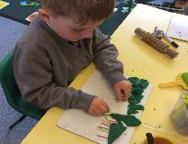
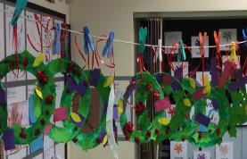
Expressive arts & Design
Creating with Materials:
Safely use and explore a variety of materials, tools and techniques, experimenting with colour, design, texture, form and function; -
Share their creations, explaining the process they have used;
Make use of props and materials when role playing characters in narratives and stories.
Being Imaginative and Expressive:
Invent, adapt and recount narratives and stories with peers and their teacher;
Sing a range of well-known nursery rhymes and songs;
Perform songs, rhymes, poems and stories with others, and – when appropriate – try to move in time with music.

Slide 14
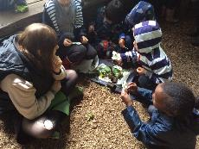
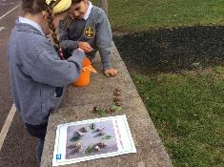
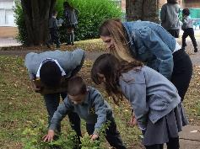
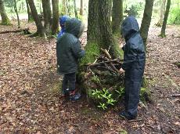
Outdoor learning / Forest Schools
The children have many opportunities to learn outside of the classroom in a range of different settings around the school grounds. These learning opportunities relate to all areas of the EYFS curriculum. For example; Creating sculptures using natural materials, Story retelling in different locations, nature scavenger hunts, number bonds using sticks/stones/flowers and using wooden sticks to create music.
Outdoor learning has so many benefits for young children. As well as links to curriculum, our main priorities outside are to target support for skills such as social behaviour, resilience, confidence, creativity, well-being, physical development (especially the larger movements) and language as there is often a wider span of opportunities outside to expand on and develop in comparison to inside play.
Children will have opportunities throughout the year to experience different activities in the school forest area such as: Den building, art with natural materials and Mini-beast identification. In addition to this, Miss Kirby is currently training to be a Forest schools leader, with the aim of setting up forest schools sessions for groups of reception children later on in the year.

Slide 15
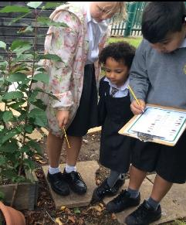
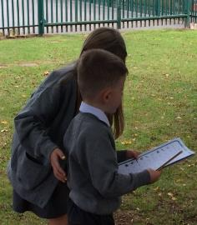
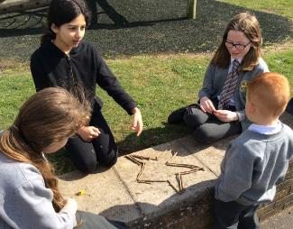
Buddies
All Reception children are buddied with a Year 6 child, once they have settled into school, and are attending full time.
The buddies usually meet on a Friday afternoon and spend some time completing an activity together, e.g. nature scavenger hunts, Art activities, consolidation of learning (relating to topics in class) and shared reading.
We hold a Buddy Tea towards the end of Term 1 to which parents/ carers are invited. This gives you a chance to meet your child’s buddy and their parents. More details to follow nearer the time.

Slide 16
Helping at homE
Some ways you can help your child prepare for starting school:
Now:
Share a range of stories and nursery rhymes with your child to help lay the foundations for developing a love of reading
Count and sing counting songs
Provide opportunities for mark making and drawing
Work with your child to help them toilet independently when they begin school
Talk about/count down to starting school
Practise putting on/taking off the school uniform
When your child starts school:
Talk about their day at school
Read at home daily and practise the phonic sounds, once phonics learning begins
Recognise numbers to at least 10, progressing to 20 and beyond as you child gains confidence.

Slide 17
Summer Term Transition activities
Meet the Teacher
Tuesday 4th July/ Wednesday 5th July
Book at meeting with Miss Blackford for you and your child. This helps us to begin to get to know your child and gives you the opportunity to ask any questions.
Stay and Play
Tuesday 11th July/ Wednesday 12th July 2:00-3.00pm
A chance for the children to spend some time in the Reception learning environment and begin to get to know the adults who will be helping them when they start school.
Your child is welcome to bring a favourite teddy/ soft toy with them- PLEASE NAME THESE.
Book these sessions this evening

Slide 18
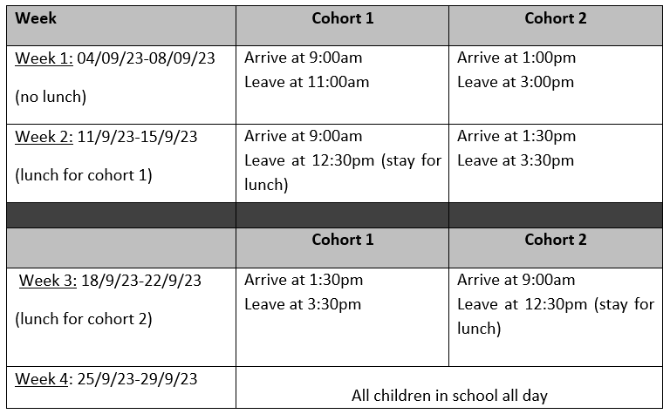
September Transition weeks

Slide 19
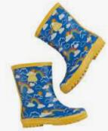


September
Please NAME EVERYTHING
Velcro shoes only as these help the children to be more independent
Please provide a pair of named wellies to be kept in school and used outdoors when needed
Please provide waterproof trousers and coat/ all in one suit to be kept in school for use on wet days in the outdoor learning area or for our Forest Skills activities
Children may choose to have a packed lunch or school dinner
Please provide your child with a named water bottle and send to school every day
A variety of fruit is provided for snack, which children have access to throughout the day
Once in school full time, the children can buy toast from the tuck shop- 10p slice
Book bags must come to school every day
Children to wear PE kit to school on PE days – you will be notified of these in September
Messages can be passed on to the class teacher/TA at drop-off or pick-up or via the Reading Record Book
Tell us if someone different will be collecting your child from school

Slide 20

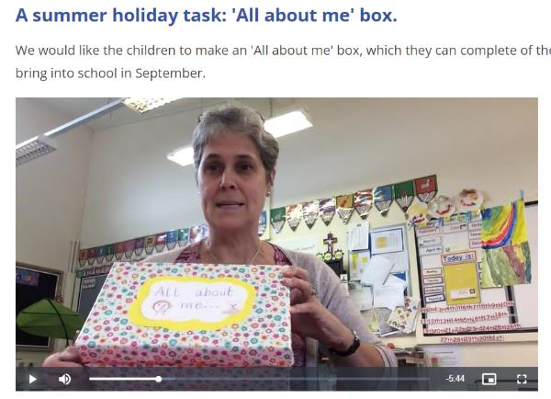
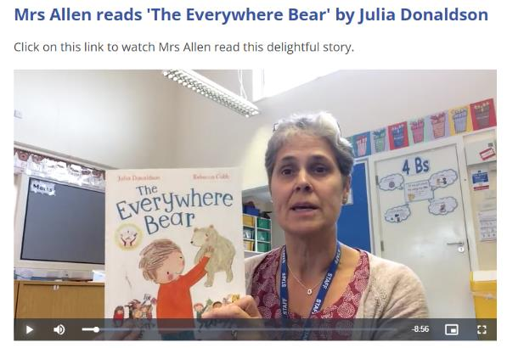
Optional Summer Tasks

